Slide 1
EPFL
Space Center eSpace
Space Propulsion
ENG-510

Slide 2
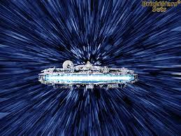

Lecture # 5
Introduction & General Course Information
Brief update on space propulsion course

Slide 3
Test Facility Visit
ERT Test Facility Visit (including firing demonstration):
Test facility visit is proposed for Wednesday, May 28 starting between 9 to
10 am
Who is interested to join?
Agenda
  Test facility tour
  Hot firing test (TBC)
Excel is uploaded on Moodle
Please fill out table
L5 - Introduction
Space Propulsion ENG-510

Slide 4
Feedback
Feedback:
Thank you
I will for sure try to consider the feedback
Difficult aspect is number of ECTS points compared to effort
L5 - Introduction
Space Propulsion ENG-510

Slide 5
Type V Pressure Vessels
Type V Propellant Tanks:
31.03.2025 BRE – AMS – GVA
01.04.2025 GVA – AMS – BRE
02.04.2025 BRE – AMS – SEA
03.04.2025 SEA – HOU
04.04.2025 HOU – ATL
05.04.2025 ATL – MUC
06.04.2025 MUC – BRE
07.04.2025 BRE – AMS – GVA
08.04.2025 GVA – AMS – BRE
L5 - Introduction
Space Propulsion ENG-510

Slide 6
Type V Pressure Vessels
Type V Propellant Tanks:
Intuitive Machines confirmed that Type V tanks were used on their lunar landers running on pressure-fed LOx / LCH4 cryogenic propellants
Composite fiber was protected on the inner side against the propellants with a dedicated sheet
Metallic toss implemented in the composite fiber on the poles
Metallic brackets were glued to the equator for tank fixation
Most probable first Type V tanks in orbit
L5 - Introduction
Space Propulsion ENG-510

Slide 7
Type V Pressure Vessels
Video
L5 - Introduction
Space Propulsion ENG-510

Slide 8
Exercise
Exercise # 4 Description:
Due date on 13.4.2025: Verification Plan
  1-pager with description on how the main requirements will be verified like parachute deployment, safe-landing (maximal speed during landing), maximal altitude below 200 m, vertical lift-off, booster separation
  Description of verification by test, by analysis, by review of design / inspection or by demonstration during assembly
  Main focus shall be put on safety, redundancy and parachute deployment
  It shall be described, how the system / the complete loaded rocket can be checked prior to launch
Evaluation on 15.4.2025 (usual time slots)
L5 - Introduction
Space Propulsion ENG-510

Slide 9
Exercise
Exercise # 5 Description:
Due date on 27.4.2025: Qualification Review
  Final report (summary of all reports so far with updates on final design / configuration) with description of the Water rocket (Description of all products used, fluidical architecture, electrical architecture, mass budget, propellant budget, pressure budget, launch phases) and clear summary of verification results performed
  Objective is to get ‘green light’ for trial launch
Evaluation on 29.4.2025 (usual time slots)
L5 - Introduction
Space Propulsion ENG-510

Slide 10
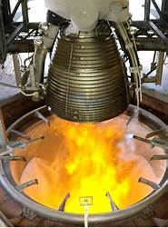
Lecture # 5
Chemical Propulsion Systems
Brief overview on all space propulsion systems

Slide 11
Which Liquid Bi-propellant Propulsion Systems exist?
Propulsion Equipment:
Valve Functions
  Fill & Drain
  Isolation
  Regulation
  Flow control
  Throttling
  …
L5 – Propulsion Systems
Space Propulsion ENG-510

Slide 12
Which Liquid Bi-propellant Propulsion Systems exist?
Propulsion Equipment:
Valve Types
  Pyro Valves (N/O – normally open – or N/C – normally closed)
  SMA Valves (Shape Memory Alloy)
  Check Valves
  Monostable Valves (Solenoid valves) – Flow Control Valves
  Bistable Valves (Latch valves)
  Pneumatic Valves
  Electric Valves
L5 – Propulsion Systems
Space Propulsion ENG-510

Slide 13
Which Liquid Bi-propellant Propulsion Systems exist?
Propulsion Equipment:
Valve Types
  Ball Valves
  Fill & Drain Valves
  Burst Disk + Relief Valve
L5 – Propulsion Systems
Space Propulsion ENG-510

Slide 14
Which Liquid Bi-propellant Propulsion Systems exist?
Propulsion Equipment:
Valve Types
  Pyro Valves (N/O – normally open – or N/C – normally closed): Redundancy
    PVs are a one shot deal
    Explosive charges are fired to open the valve (normally closed type) or to close the
    valve (normally open type
    PVs are used to permanently change the flow paths within the propulsion system
    Better leakage rate than latch or solenoid valves
    Cost effective
L5 – Propulsion Systems
Space Propulsion ENG-510

Slide 15
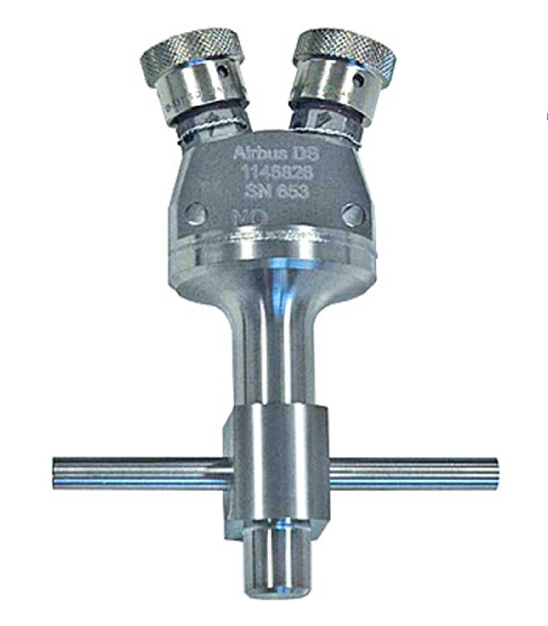
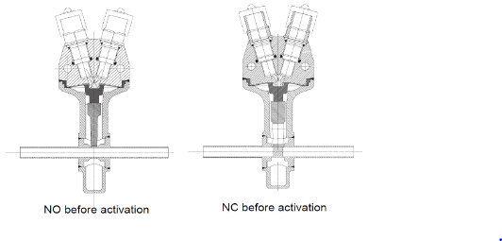
Which Liquid Bi-propellant Propulsion Systems exist?
Propulsion Equipment:
Valve Types
  Pyro Valves (N/O – normally open – or N/C – normally closed): Redundancy
L5 – Propulsion Systems
Space Propulsion ENG-510

Slide 16
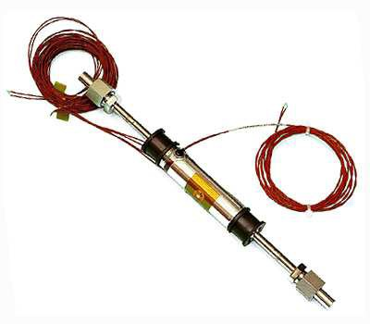
Which Liquid Bi-propellant Propulsion Systems exist?
Propulsion Equipment:
Valve Types
  SMA Valves (Shape Memory Alloy): Low shock but duration for temperature increase
L5 – Propulsion Systems
Space Propulsion ENG-510

Slide 17
Which Liquid Bi-propellant Propulsion Systems exist?
Propulsion Equipment:
Valve Types
  Check Valves: Never tight + oscillations
    Non return valves prevent the mixing of oxidiser and fuel vapour in the pipes
    No electronic parts
    Valves allow the flow of gas in one direction only
    Valves can exert a high pressure drop in the system (especially when series redundant)
    Good reliability
L5 – Propulsion Systems
Space Propulsion ENG-510

Slide 18
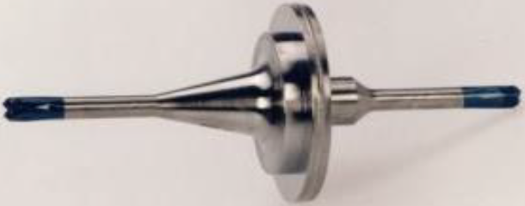
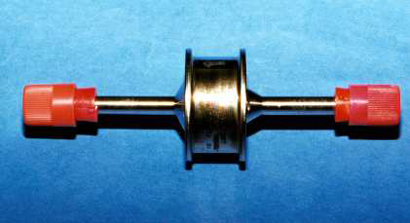
Which Liquid Bi-propellant Propulsion Systems exist?
Propulsion Equipment:
Valve Types
  Check Valves: Never tight + oscillations
L5 – Propulsion Systems
Space Propulsion ENG-510

Slide 19
Which Liquid Bi-propellant Propulsion Systems exist?
Propulsion Equipment:
Valve Types:
  Monostable Valves (Solenoid valves): Pressure assisted or not + force balance (also in dynamic case) + heating
    Solenoid valve is a monostable valve
    “Normally closed” version will only remain open whilst powered, where after they
    return to closed position
    “Normally open” versions are also available
    As with the latch valve, they are used to control propellant flow around the system
L5 – Propulsion Systems
Space Propulsion ENG-510

Slide 20
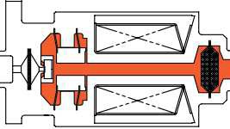
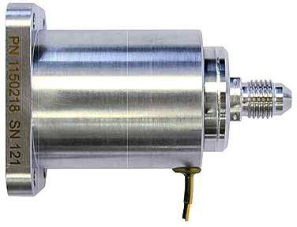
Which Liquid Bi-propellant Propulsion Systems exist?
Propulsion Equipment:
Valve Types:
  Monostable Valves (Solenoid valves):
L5 – Propulsion Systems
Space Propulsion ENG-510
In-line SV

Slide 21
Which Liquid Bi-propellant Propulsion Systems exist?
Propulsion Equipment:
Valve Types
  Bistable Valves (Latch valves): Force balance (also in dynamic case) + power need
    Latch valve is a bistable valve
    The position open/closed is controlled by a short electrical pulse on demand
    Most examples contain an internal position indicator to determine valve position
    The function of the valve is to control propellant (sometimes gas)
    flow around the propulsion system
L5 – Propulsion Systems
Space Propulsion ENG-510

Slide 22
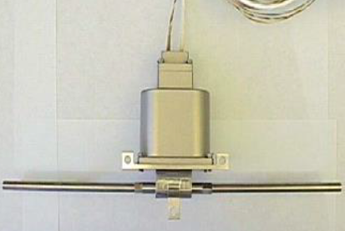
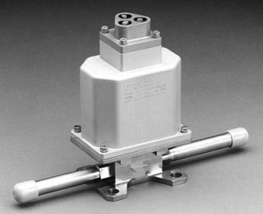
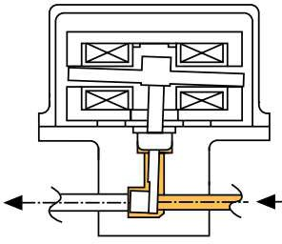
Which Liquid Bi-propellant Propulsion Systems exist?
Propulsion Equipment:
Valve Types
  Bistable Valves (Latch valves): Force balance (also in dynamic case) + power need
L5 – Propulsion Systems
Space Propulsion ENG-510

Slide 23
Which Liquid Bi-propellant Propulsion Systems exist?
Propulsion Equipment:
Valve Types
  Test Ports, Fill and Drain Valves or Fill and Vent Valves (FDV, FVV or TP)
    The name determines the function, but all are fundamentally the same valve
    They are used on ground to enable fluids to be put into the system, or to perform tests on ground
    The valves are operated using a counterpart called a ground half coupling
    Often called Mechanical Valves, Service Valves or Flight Half Couplings
L5 – Propulsion Systems
Space Propulsion ENG-510

Slide 24
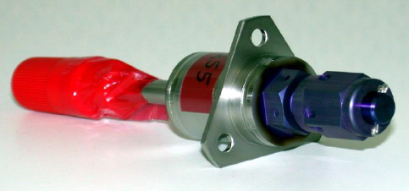
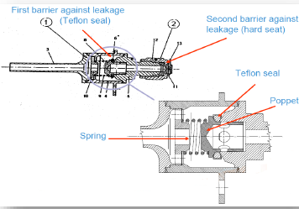
Which Liquid Bi-propellant Propulsion Systems exist?
Propulsion Equipment:
Valve Types
  Test Ports, Fill and Drain Valves or Fill and Vent Valves (FDV, FVV or TP)
L5 – Propulsion Systems
Space Propulsion ENG-510

Slide 25
Which Liquid Bi-propellant Propulsion Systems exist?
Propulsion Equipment:
Valve Types
  Burst Disk & Relief Valves:
    Pressure relief valve will be set to a pre-determined “cracking pressure”
    If the pressure gets too high within the system the relief valve vents gas to prevent over pressurization (particularly tanks)
    Burst discs work in the same way, but once opened, they cannot be closed
    They are not particularly desirable as the reliability of the system can be impaired –analytical design solutions are better
L5 – Propulsion Systems
Space Propulsion ENG-510

Slide 26
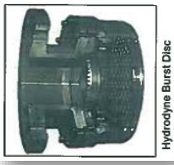
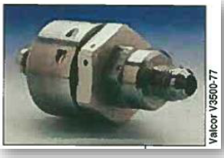
Which Liquid Bi-propellant Propulsion Systems exist?
Propulsion Equipment:
Valve Types
  Burst Disk & Relief Valves:
L5 – Propulsion Systems
Space Propulsion ENG-510

Slide 27

Which Liquid Bi-propellant Propulsion Systems exist?
Propulsion Equipment:
Valve Types
  And everything can be a little bit smaller…
L5 – Propulsion Systems
Space Propulsion ENG-510

Slide 28
Which Liquid Bi-propellant Propulsion Systems exist?
Propulsion Equipment:
Other propulsion equipment
  Transducer (Pressure, Temperature, Flow rate, Position indication, Acceleration)
  Filter (Liquid and Gaseous)
  Heater
  Heat exchanger
  Electrolyzer
  Sabatier Reactor
  Compressor
  …
L5 – Propulsion Systems
Space Propulsion ENG-510

Slide 29
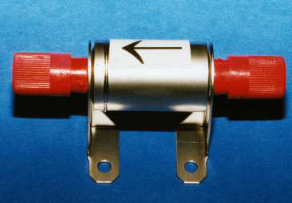
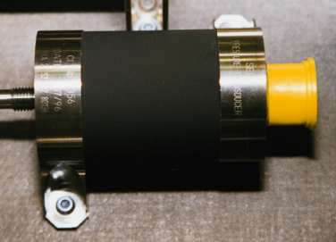
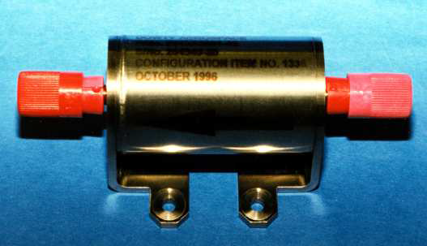
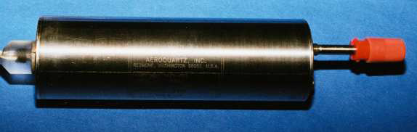
Which Liquid Bi-propellant Propulsion Systems exist?
Propulsion Equipment:
L5 – Propulsion Systems
Space Propulsion ENG-510
He - Filter
Pressure Transducer
Propellant Filter
Pressure Transducer High Accuracy

Slide 30
Which Liquid Bi-propellant Propulsion Systems exist?
Propulsion Equipment:
Other propulsion equipment
  Transducer (Pressure, Temperature, Flow rate, Position indication, Acceleration)
    Pressure transducers convert physical pressure into an equivalent electrical signal
    PTs are typically powered continuously through life
    PTs are used to monitor pressure which is used to determine
    Correct function of the system (Propellant gauging calculations, Thruster performance)
    The PTs come in various low and high pressure ranges and are calibrated during supplier testing
L5 – Propulsion Systems
Space Propulsion ENG-510

Slide 31
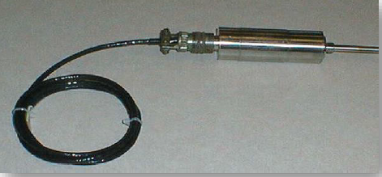
Which Liquid Bi-propellant Propulsion Systems exist?
Propulsion Equipment:
Other propulsion equipment
  Transducer (Pressure, Temperature, Flow rate, Position indication, Acceleration)
L5 – Propulsion Systems
Space Propulsion ENG-510

Slide 32
Which Liquid Bi-propellant Propulsion Systems exist?
Propulsion Equipment:
Other propulsion equipment
  Filter (Liquid and Gaseous)
    Filters are used to filter particulate from gas or propellant to protect downstream components
    The propulsion systems are precision cleaned during assembly, however residual particulate and debris created from pyro valves can damage valves
    Filters will exert a pressure drop at high flow rates, which must be taken into account
L5 – Propulsion Systems
Space Propulsion ENG-510

Slide 33
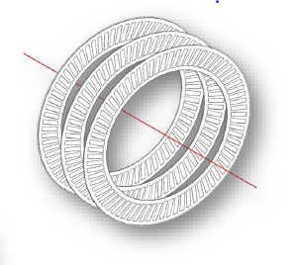
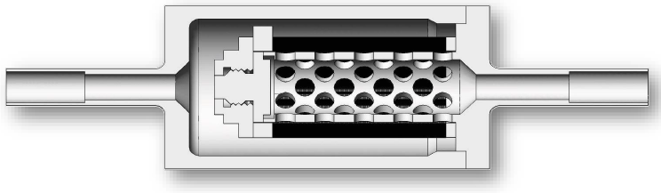
Which Liquid Bi-propellant Propulsion Systems exist?
Propulsion Equipment:
Other propulsion equipment
  Filter (Liquid and Gaseous)
L5 – Propulsion Systems
Space Propulsion ENG-510

Slide 34
Which Liquid Bi-propellant Propulsion Systems exist?
Propulsion Equipment:
And thruster for sure…
L5 – Propulsion Systems
Space Propulsion ENG-510

Slide 35
Which Liquid Bi-propellant Propulsion Systems exist?
Propulsion Equipment:
Bi-propellant thruster definitions:
  Steady State
    Refers to the configuration where the thruster valves are fully open
    Continuous thrust is produced (provided conditions remain stable)
L5 – Propulsion Systems
Space Propulsion ENG-510

Slide 36
Which Liquid Bi-propellant Propulsion Systems exist?
Propulsion Equipment:
Bi-propellant thruster definitions:
  Pulse Mode
    At the same pressure, a net lower thrust can be produced by cycling the valve producing a series of impulsive pulses for more accurate positioning
    The Impulse bit is the equivalent thrust which can be produced for a given pulse
    Minimum Impulse bit is the smallest possible amount of thrust which can be produced by a thruster for given operating conditions
L5 – Propulsion Systems
Space Propulsion ENG-510

Slide 37
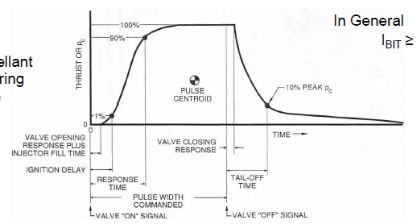
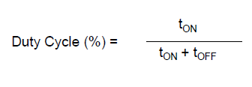
Which Liquid Bi-propellant Propulsion Systems exist?
Propulsion Equipment:
Bi-propellant thruster definitions:
  Pulse Mode
    Duty cycle
  Transient Phases
    Thrust rise time
    Thrust decay time
L5 – Propulsion Systems
Space Propulsion ENG-510

Slide 38
Which Liquid Bi-propellant Propulsion Systems exist?
Propulsion Equipment:
Bi-propellant thrusters / engines
  Injection method for propellants (e.g. spin, showerhead, …)
  Cooling of engine
  Trimming of engine
  Ignition of propellants
L5 – Propulsion Systems
Space Propulsion ENG-510

Slide 39
Which Liquid Bi-propellant Propulsion Systems exist?
Propulsion Equipment:
Bi-propellant thrusters / engines
  Trimming / calibration of engine
      Orifice (passive)
      Throttling valve / injector (active)
L5 – Propulsion Systems
Space Propulsion ENG-510

Slide 40
Which Liquid Bi-propellant Propulsion Systems exist?
Propulsion Equipment:
Bi-propellant thrusters / engines
  Cooling of engine (Combustion Chamber, Throat, Nozzle Extension)
    Radiative cooling
    Capacitive cooling (Phase change material)
    Film cooling
    Vortex cooling
    Regenerative cooling
    Ablative cooling
    Transpiration cooling
L5 – Propulsion Systems
Space Propulsion ENG-510

Slide 41
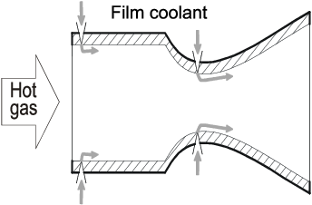
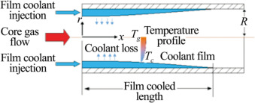
Which Liquid Bi-propellant Propulsion Systems exist?
Propulsion Equipment:
Bi-propellant thrusters / engines
  Cooling of engine (Combustion Chamber, Throat, Nozzle Extension)
    Film cooling
L5 – Propulsion Systems
Space Propulsion ENG-510

Slide 42
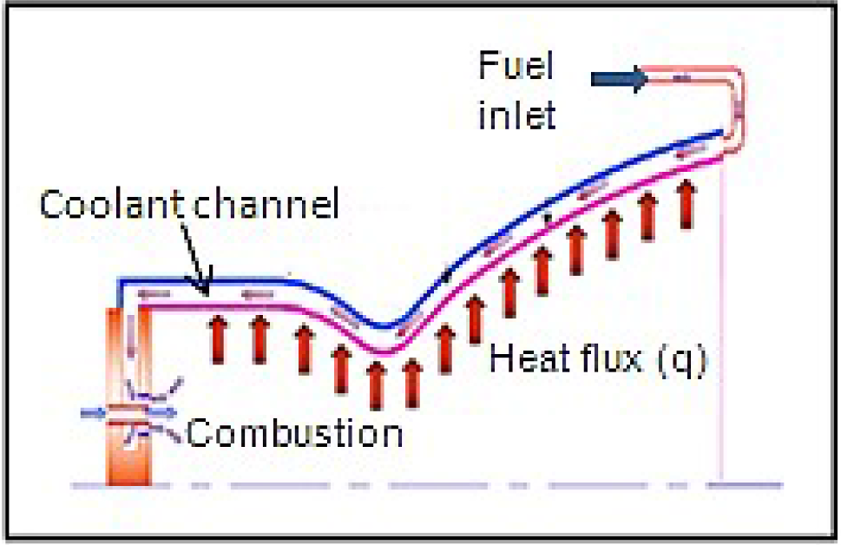
Which Liquid Bi-propellant Propulsion Systems exist?
Propulsion Equipment:
Bi-propellant thrusters / engines
  Cooling of engine (Combustion Chamber, Throat, Nozzle Extension)
    Regenerative cooling
L5 – Propulsion Systems
Space Propulsion ENG-510

Slide 43
Which Liquid Bi-propellant Propulsion Systems exist?
Propulsion Equipment:
Bi-propellant thrusters / engines
  Cooling of engine (Combustion Chamber, Throat, Nozzle Extension)
    Vortex cooling
L5 – Propulsion Systems
Space Propulsion ENG-510

Slide 44
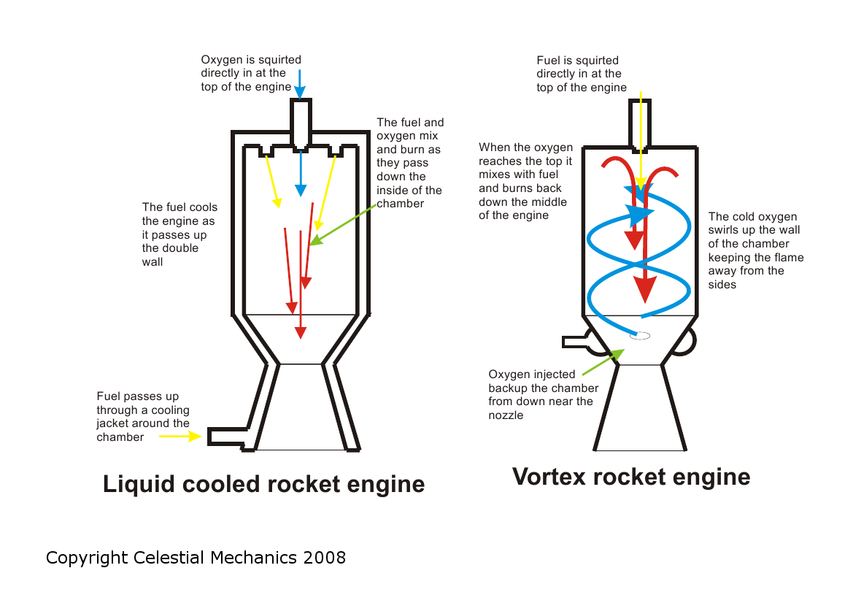
Which Liquid Bi-propellant Propulsion Systems exist?
L5 – Propulsion Systems
Space Propulsion ENG-510

Slide 45
Which Liquid Bi-propellant Propulsion Systems exist?
Propulsion Equipment:
Bi-propellant thrusters / engines
  Injection method for propellants (e.g. spin, showerhead, …)
    Impingement
    Showerhead
    Concentric tube (with or without swirl)
    Splash plate
L5 – Propulsion Systems
Space Propulsion ENG-510

Slide 46
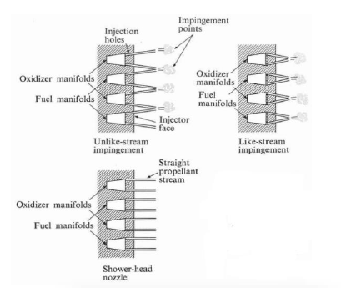
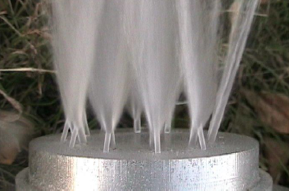
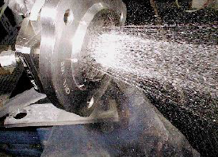
Which Liquid Bi-propellant Propulsion Systems exist?
Propulsion Equipment:
Bi-propellant thrusters / engines
  Injection method for propellants (e.g. spin, showerhead, …)
L5 – Propulsion Systems
Space Propulsion ENG-510

Slide 47
Which Liquid Bi-propellant Propulsion Systems exist?
Propulsion Equipment:
Bi-propellant thrusters / engines
  Ignition of propellants
    Hypergolic ignition
    Catalytic decomposition
    Thermal decomposition
    …
L5 – Propulsion Systems
Space Propulsion ENG-510

Slide 48
Which Liquid Bi-propellant Propulsion Systems exist?
Propulsion Equipment :
Bi-propellant thrusters / engines
  Ignition of propellants
    Spark plug
    Glow plug
    Laser ignitor
    Resonance acoustic ignition
    Thermal wire
    …
    Torch ignitor (Different propellant or same propellants with smaller amount)
L5 – Propulsion Systems
Space Propulsion ENG-510

Slide 49
Which Liquid Bi-propellant Propulsion Systems exist?
Propulsion System Combination:
Dual Mode Propulsion
  Dual Mode systems combine elements of monopropellant and bipropellant systems
  Dual mode propulsion system can have a high thrust bipropellant engine and small precise monopropellant engines
  Or resistojets or arcjets may be used instead of catalytic hydrazine thrusters
L5 – Propulsion Systems
Space Propulsion ENG-510

Slide 50
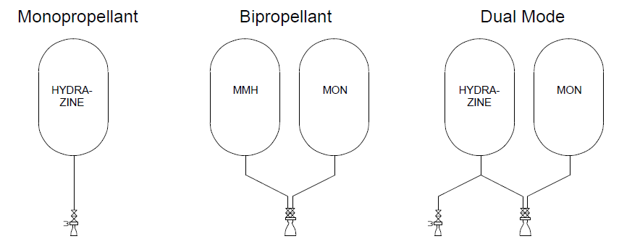
Which Liquid Bi-propellant Propulsion Systems exist?
Propulsion System Combination:
Dual Mode Propulsion
L5 – Propulsion Systems
Space Propulsion ENG-510

Slide 51
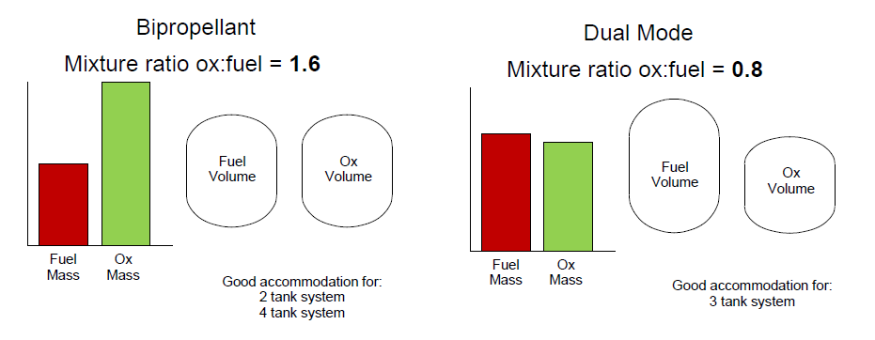
Which Liquid Bi-propellant Propulsion Systems exist?
Propulsion System Combination:
Dual Mode Propulsion
L5 – Propulsion Systems
Space Propulsion ENG-510

Slide 52
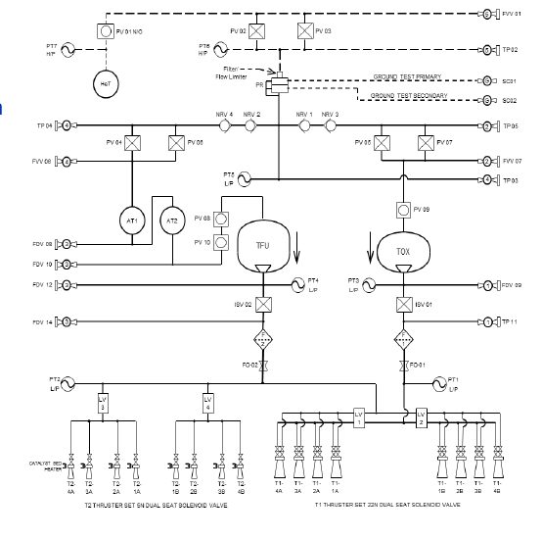
Which Liquid Bi-propellant Propulsion Systems exist?
Propulsion System Combination:
Dual Mode Propulsion
  Example: Bepi Colombo
L5 – Propulsion Systems
Space Propulsion ENG-510

Slide 53
Which Liquid Bi-propellant Propulsion Systems exist?
Propulsion System Combination:
Mixed Mode Propulsion
  Mixed Mode propulsion refers to the use of different propellant types with one thruster:
    Cold gas, mono-prop or bi-prop operation of a thruster
    Small flow (igniter flow) or full flow
L5 – Propulsion Systems
Space Propulsion ENG-510

Slide 54
Which Chemical Propulsion Systems exist?
Gaseous propulsion systems
Liquid propulsion systems
Gelled propulsion systems
Combustion
Hybrid propulsion systems
L5 – Propulsion Systems
Chemical Propulsion Systems
Space Propulsion ENG-510
Solid propulsion systems
Rotation Detonation Engine
Detonation
Pulse Detonation Engine

Slide 55
Which Chemical Propulsion Systems exist?
Tri-propellant
Mono-propellant
Liquid propulsion systems
Combustion
Bi-propellant
L5 – Propulsion Systems
Chemical Propulsion Systems
Space Propulsion ENG-510
Rotation Detonation Engine
Detonation
Pulse Detonation Engine

Slide 56
Which Chemical Propulsion Systems exist?
Tri-propellant
Mono-propellant
Liquid propulsion systems
Combustion
Bi-propellant
L5 – Propulsion Systems
Chemical Propulsion Systems
Space Propulsion ENG-510
Rotation Detonation Engine
Detonation
Pulse Detonation Engine

Slide 57
Which Liquid Tri-propellant Propulsion Systems exist?
Chemical Propulsion Systems:
Liquid propulsion systems
  Monopropellant, bi-propellant or tri-propellant
  Storable or cryogenic propellants
  Toxic or non-toxic (hazardous or green) propellants
  Hypergolic or non-hypergolic propellants
  Pressure-fed (self-pressurization, blow-down or regulated) or pump-fed propulsion
L5 – Propulsion Systems
Space Propulsion ENG-510

Slide 58
Which Liquid Bi-propellant Propulsion Systems exist?
Propellant Phase in Tanks
Solid
Liquid
Gas
Two liquid propellants with metallic additives or three liquid propellants
A
B
  C
    D
Combustion
Tri-propellant Thruster
L5 – Propulsion Systems
Space Propulsion ENG-510
Chemical Reaction
Decomp
No

Slide 59
Which Liquid Tri-propellant Propulsion Systems exist?
Architecture for Liquid Tri-propellant Combustion Propulsion Systems:
R
Regulator
L5 – Propulsion Systems
Regulator
R
Tank
Valve
Space Propulsion ENG-510
Exhaust
Pressurant
Tank
Pressurant
Tank
Valve
Tank
Combustion

Slide 60
Which Liquid Tri-propellant Propulsion Systems exist?
Liquid tri-propellant propulsion systems:
  A tri-propellant rocket is a rocket that uses three propellants, as opposed to the more common bi-propellant rocket or monopropellant rocket designs, which use two or one propellants, respectively
  Tri-propellant systems can be designed to have high specific impulse and have been investigated for single stage to orbit designs
  While tri-propellant engines have been tested, no tri-propellant rocket has been built or flown
L5 – Propulsion Systems
Space Propulsion ENG-510

Slide 61
Which Liquid Tri-propellant Propulsion Systems exist?
Liquid tri-propellant propulsion systems:
  There are two different kinds of tri-propellant rockets
  One is a rocket engine which mixes three separate streams of propellants, burning all three propellants simultaneously respectively some solid additives are pre-mixed into the liquid fuel and such two separate streams of propellant are injected simultaneously
  The other kind of tri-propellant rocket is one that uses one oxidizer but two fuels, burning the two fuels in sequence during the flight
L5 – Propulsion Systems
Space Propulsion ENG-510

Slide 62
Which Liquid Tri-propellant Propulsion Systems exist?
Liquid tri-propellant propulsion systems:
  Simultaneous tri-propellant systems often involve the use of a high energy density metal additive (Beryllium or Lithium) with existing bi-propellant systems
  In these motors, the burning of the fuel with the oxidizer provides an activation energy needed for a more energetic reaction between the oxidizer and the metal (a kind of staged combustion)
  While theoretical modeling of these systems suggests an advantage over bipropellant motors, several factors limit their practical implementation, including the difficulty of injecting solid metal into the thrust chamber; heat, mass, and momentum transport limitations across phases; and the difficulty of achieving and sustaining combustion of the metal
L5 – Propulsion Systems
Space Propulsion ENG-510

Slide 63
Which Liquid Tri-propellant Propulsion Systems exist?
Liquid tri-propellant propulsion systems:
  In the 1960s, an engine was fired using a mixture of liquid lithium, gaseous hydrogen, and liquid fluorine to produce a specific impulse of 542 s
  In sequential tri-propellant rockets, the fuel is changed during flight, so the motor can combine the high thrust of a dense fuel like kerosene early in flight with the high specific impulse of a lighter fuel like liquid hydrogen (LH2) later in flight
  The result is a single engine providing some of the benefits of staging
L5 – Propulsion Systems
Space Propulsion ENG-510

Slide 64
Which Chemical Propulsion Systems exist?
Gaseous propulsion systems
Liquid propulsion systems
Gelled propulsion systems
Combustion
Hybrid propulsion systems
L5 – Propulsion Systems
Chemical Propulsion Systems
Space Propulsion ENG-510
Solid propulsion systems
Rotation Detonation Engine
Detonation
Pulse Detonation Engine

Slide 65
Which Gelled Propulsion Systems exist?
Chemical Propulsion Systems
  Gaseous propulsion systems
  Liquid propulsion systems
  Gelled propulsion systems
  Solid propulsion systems
  Hybrid (liquid / solid) propulsion systems
L5 – Propulsion Systems
Space Propulsion ENG-510

Slide 66
Which Gelled Propulsion Systems exist?
Propellant Phase in Tanks
Solid
Liquid
Gas
Chemical Propulsion Systems
  Gaseous propulsion systems
  Liquid propulsion systems
  Gelled propulsion systems
  Solid propulsion systems
  Hybrid (liquid / solid) propulsion systems
Combustion
Gelled
Liquid Thruster
L5 – Propulsion Systems
Space Propulsion ENG-510
Chemical Reaction
Decomp
No

Slide 67
Which Gelled Propulsion Systems exist?
Architecture for Gelled Bi-propellant Combustion Propulsion Systems:
Regulator
R
Regulator
L5 – Propulsion Systems
R
Tank
Space Propulsion ENG-510
Valve
Pressurant
Tank
Exhaust
Pressurant
Tank
Valve
Combustion

Slide 68
Which Gelled Propulsion Systems exist?
Gelled Propulsion Systems:
  Gelled propellants are produced from liquid fuels and gelling agents
  Once in a tank, i.e. in idle state, they change from solid into liquid state when shear stress is applied
  This particular feature provides a combination of major advantages to gelled propellants for use in liquid and solid propellants
  Developing such highly performing and advantageous propellants requires still comprehensive research
L5 – Propulsion Systems
Space Propulsion ENG-510

Slide 69
Which Gelled Propulsion Systems exist?
Gelled Propulsion Systems:
  Physical-chemical laboratory is needed to analyze rheological and physical features of gelled propellants, like viscosity and surface tension
  The special rheological and physical features of gelled propellants may differ significantly from conventional liquid fuels in terms of fuel conditioning (vaporization and injection) in the combustion chamber
  While certain gelled propellants show rather similar vaporization behavior compared to traditional liquid fuels, others may react with entirely different vaporization images
L5 – Propulsion Systems
Space Propulsion ENG-510

Slide 70
Which Gelled Propulsion Systems exist?
Gelled Propulsion Systems:
  Therefore, detailed vaporization tests in separate experimental structures are needed
  At DLR Lampoldshausen, the application of gelled propellants is tested in modular model combustion chambers
  Gathered data are used to identify appropriate combustion chamber processes and to evaluate the performance characteristics of such propulsions
L5 – Propulsion Systems
Space Propulsion ENG-510

Slide 71
Which Chemical Propulsion Systems exist?
Gaseous propulsion systems
Liquid propulsion systems
Gelled propulsion systems
Combustion
Hybrid propulsion systems
L5 – Propulsion Systems
Chemical Propulsion Systems
Space Propulsion ENG-510
Solid propulsion systems
Rotation Detonation Engine
Detonation
Pulse Detonation Engine

Slide 72
Which Solid Propulsion Systems exist?
Chemical Propulsion Systems:
  Gaseous propulsion systems
  Liquid propulsion systems
  Gelled propulsion systems
  Solid propulsion systems
  Hybrid (liquid / solid) propulsion systems
L5 – Propulsion Systems
Space Propulsion ENG-510

Slide 73
Which Solid Propulsion Systems exist?
Propellant Phase in Tanks
Solid
Liquid
Gas
Double base or composite
Chemical Propulsion Systems
  Gaseous propulsion systems
  Liquid propulsion systems
  Gelled propulsion systems
  Solid propulsion systems
  Hybrid (liquid / solid) propulsion systems
  C
    D
Combustion
Bi-prop Thruster
L5 – Propulsion Systems
Space Propulsion ENG-510
Chemical Reaction
Decomp
No

Slide 74
Which Solid Propulsion Systems exist?
Architecture for Solid Propulsion Systems:
Tank
Exhaust
L5 – Propulsion Systems
Space Propulsion ENG-510
Igniter
Combustion Chamber
Throat Orifice

Slide 75
Which Solid Propulsion Systems exist?
Solid Propulsion Systems:
  Performance comparison
  A solid fuel-oxidizer mixture (propellant) is packed into the rocket, with a cylindrical hole in the middle
  An igniter combusts the surface of the propellant
  The cylindrical hole in the propellant acts as a combustion chamber
  The hot exhaust is choked at the throat, which, among other things, dictates the amount of thrust produced
  Exhaust exits the rocket
L5 – Propulsion Systems
Space Propulsion ENG-510

Slide 76
Which Solid Propulsion Systems exist?
Solid Propulsion Systems:
  Casing
  Casing may be constructed from a range of materials
    Steel was used for the Space Shuttle boosters
    Filament-wound graphite epoxy casings are used for high-performance motors
  Casing must be designed to withstand the pressure and resulting stresses of the rocket motor, possibly at elevated temperature
  To protect the casing from corrosive hot gases, a sacrificial thermal liner on the inside of the casing is often implemented, which ablates to prolong the life of the motor casing
L5 – Propulsion Systems
Space Propulsion ENG-510

Slide 77
Which Solid Propulsion Systems exist?
Solid Propulsion Systems:
  Nozzle
  A convergent-divergent design accelerates the exhaust gas out of the nozzle to produce thrust
  The nozzle must be constructed from a material that can withstand the heat of the combustion gas flow
  Often, heat-resistant carbon-based materials are used, such as amorphous graphite or reinforced carbon-carbon
  Some designs include directional control of the exhaust by gimballing the nozzle
L5 – Propulsion Systems
Space Propulsion ENG-510

Slide 78
Which Solid Propulsion Systems exist?
Solid Propulsion Systems:
  Performance comparison
  Key parameter for the solid propulsion system performance is the burn rate
  (e.g. cm / s) together with the burning area and the solid propellant density
L5 – Propulsion Systems
Space Propulsion ENG-510

Slide 79
Which Solid Propulsion Systems exist?
L5 – Propulsion Systems
Space Propulsion ENG-510

Slide 80
Which Solid Propulsion Systems exist?
Solid Propulsion Systems:
  Advantages
  Simple
  High thrust
  Thrust can be adapted
  Disadvantages
  Not stoppable
  Toxic
L5 – Propulsion Systems
Space Propulsion ENG-510

Slide 81
Which Solid Propulsion Systems exist?
Solid Propulsion Systems:
  Propellant Types
  Double-base propellants
  Composite propellants
  Black powder (gun-powder) propellant
  Zinc–sulfur (ZS) propellants
  "Candy" propellants (sugar fuel)
  High-energy composite (HEC) propellants
  Composite modified double base propellants
  Minimum-signature (smokeless) propellants
  Electric solid propellants
L5 – Propulsion Systems
Space Propulsion ENG-510

Slide 82
Which Solid Propulsion Systems exist?
Solid Propulsion Systems:
  Propellant Types
  Double-base propellants
    DB propellants are composed of two monopropellant fuel components where one typically acts as a high-energy (yet unstable) monopropellant and the other acts as a lower-energy stabilizing and gelling monopropellant
    In typical circumstances, Nitroglycerin is dissolved in a gel and solidified with additives
    DB propellants are implemented in applications where a medium-high Isp of roughly 235 s is required
    Addition of metal fuels (such as Aluminium) can increase performance to around 250 s
L5 – Propulsion Systems
Space Propulsion ENG-510

Slide 83
Which Solid Propulsion Systems exist?
Solid Propulsion Systems:
  Propellant Types
  Composite propellants
    A powdered oxidizer and powdered metal fuel are intimately mixed and immobilized with a rubbery binder (that also acts as a fuel)
    Composite propellants are often either ammonium nitrate-based (ANCP) or ammonium perchlorate-based (APCP)
    Ammonium nitrate composite propellant often uses magnesium and / or aluminium as fuel and delivers medium performance (Isp of about 210 s)
    Ammonium perchlorate composite propellant often uses aluminium fuel and delivers high performance: vacuum (Isp up to 296 s)
L5 – Propulsion Systems
Space Propulsion ENG-510

Slide 84
Which Solid Propulsion Systems exist?
Solid Propulsion Systems:
  Propellant Types
  Composite propellants
    Aluminium is used as fuel because it has a reasonable specific energy density, a high volumetric energy density, and is difficult to ignite accidentally
    Composite propellants are cast, and retain their shape after the rubber binder, such as Hydroxyl-terminated polybutadiene (HTPB), cross-links (solidifies) with the aid of a curative additive
    Because of its high performance, moderate ease of manufacturing, and moderate cost, APCP finds widespread use in space rockets and military rockets
L5 – Propulsion Systems
Space Propulsion ENG-510

Slide 85
Which Solid Propulsion Systems exist?
Solid Propulsion Systems:
  More exotic propellant types
  Black powder (gun-powder) propellant
    Black powder (gunpowder) is composed of charcoal (fuel), potassium nitrate (oxidizer), and sulfur (fuel and catalyst)
    It is one of the oldest pyrotechnic compositions with application to rocketry
    In modern times, black powder finds use in low-power model rockets
    The Isp of black powder is low, around 80 s
L5 – Propulsion Systems
Space Propulsion ENG-510

Slide 86
Which Solid Propulsion Systems exist?
Solid Propulsion Systems:
  More exotic propellant types
  Zinc–sulfur (ZS) propellants
    Composed of powdered zinc metal and powdered sulfur (oxidizer), ZS or "micrograin" is another pressed propellant that does not find any practical application outside specialized amateur rocketry circles due to its poor performance (as most ZS burns outside the combustion chamber) and fast linear burn rates on the order of 2 m/s
    ZS is most often employed as a novelty propellant as the rocket accelerates extremely quickly leaving a spectacular large orange fireball behind it
L5 – Propulsion Systems
Space Propulsion ENG-510

Slide 87
Which Solid Propulsion Systems exist?
Solid Propulsion Systems:
  More exotic propellant types
  "Candy" propellants (sugar fuel)
    In general, rocket candy propellants are an oxidizer (typically potassium nitrate) and a sugar fuel (typically dextrose, sorbitol or sucrose) that are cast into shape by gently melting the propellant constituents together and pouring or packing the amorphous colloid into a mold
    Candy propellants generate a low-medium specific impulse of roughly 130 s
L5 – Propulsion Systems
Space Propulsion ENG-510

Slide 88
Which Solid Propulsion Systems exist?
Solid Propulsion Systems:
  More exotic propellant types
  High-energy composite (HEC) propellants
    Typical HEC propellants start with a standard composite propellant mixture (such as APCP) and add a high-energy explosive to the mix
    This extra component usually is in the form of small crystals of RDX or HMX, both of which have higher energy than ammonium perchlorate
    Despite a modest increase in specific impulse, implementation is limited due to the increased hazards of the high-explosive additives
L5 – Propulsion Systems
Space Propulsion ENG-510

Slide 89
Which Solid Propulsion Systems exist?
Solid Propulsion Systems:
  More exotic propellant types
  Composite modified double base propellants
    Composite modified double base propellants start with a nitrocellulose / nitroglycerin double base propellant as a binder and add solids (typically ammonium perchlorate (AP) and powdered aluminium) normally used in composite propellants
    The ammonium perchlorate makes up the oxygen deficit introduced by using nitrocellulose, improving the overall specific impulse
    The aluminium improves specific impulse as well as combustion stability
    The mixing of composite and double base propellant ingredients has become so common as to blur the functional definition of double base propellants
L5 – Propulsion Systems
Space Propulsion ENG-510

Slide 90
Which Solid Propulsion Systems exist?
Solid Propulsion Systems:
  More exotic propellant types
  Minimum-signature (smokeless) propellants
    One of the most active areas of solid propellant research is the development of high-energy, minimum-signature propellant using C6H6N6(NO2)6, which has 14% higher energy per mass and 20% higher energy density than HMX
    The new propellant has been successfully developed and tested in tactical rocket motors
    The propellant is non-polluting: acid-free, solid particulates-free, and lead-free
    It is also smokeless and has only a faint shock diamond pattern that is visible in the otherwise transparent exhaust
    Production costs remain high
L5 – Propulsion Systems
Space Propulsion ENG-510

Slide 91
Which Solid Propulsion Systems exist?
Solid Propulsion Systems:
  More exotic propellant types
  Electric solid propellants
    Electric solid propellants (ESPs) are a family of high performance plastisol solid propellants that can be ignited and throttled by the application of electric current
    Unlike conventional rocket motor propellants that are difficult to control and extinguish, ESPs can be ignited reliably at precise intervals and durations
    It requires no moving part and the propellant is insensitive to flames or electrical sparks
L5 – Propulsion Systems
Space Propulsion ENG-510

Slide 92
Which Solid Propulsion Systems exist?
Solid Propulsion Systems:
  A
  C
    D
L5 – Propulsion Systems
Space Propulsion ENG-510

Slide 93
Which Solid Propulsion Systems exist?
Solid Propulsion Systems:
  A
  C
    D
L5 – Propulsion Systems
Space Propulsion ENG-510

Slide 94
Which Solid Propulsion Systems exist?
Solid Propulsion Systems:
  Example: Small acceleration rocket for stage separation (de-orbiting)
L5 – Propulsion Systems
Space Propulsion ENG-510

Slide 95
Which Solid Propulsion Systems exist?
Solid Propulsion Systems:
  A
  C
    D
L5 – Propulsion Systems
Space Propulsion ENG-510

Slide 96
Which Solid Propulsion Systems exist?
Solid Propulsion Systems:
  Question: How to distinguish a solid propellant engine?
  Answer from Los Alamos National Laboratory
  A solid rocket is simple, with only a few major components. It includes a combustion chamber containing an ignition system and propellant, and an exhaust nozzle. LANL recently developed a safer propellant system with separated solid fuel and solid oxidizer
  For ignition, LANL replaced traditional pyrotechnics with water. Once on orbit and just prior to a burn, an electrolyzer would separate the water into hydrogen and oxygen gases. At the moment of ignition, the hydrogen and oxygen would be rapidly injected into the combustion chamber and lit by a spark. The resulting flame would ignite the solid propellant
L5 – Propulsion Systems
Space Propulsion ENG-510

Slide 97
Which Solid Propulsion Systems exist?
Solid Propulsion Systems:
  Question: How to distinguish a solid propellant engine?
  Answer from Los Alamos National Laboratory
  The next challenge was to figure out how to extinguish the burn. It has long been understood that a rapid decompression of the chamber can reliably cause a solid rocket to extinguish
  LANL developed an aerospike nozzle with a changeable choke area. Once the burn has achieved a desired velocity change, the choke area would be opened, decompressing the chamber and extinguishing the burn. When another burn of the rocket is needed, the choke area is reset to its original position. Repeat as needed.
  LANL recently demonstrated multiple independent burns from a single solid rocket in static test stands at Los Alamos
L5 – Propulsion Systems
Space Propulsion ENG-510

Slide 98
Which Chemical Propulsion Systems exist?
Gaseous propulsion systems
Liquid propulsion systems
Gelled propulsion systems
Combustion
Hybrid propulsion systems
L5 – Propulsion Systems
Chemical Propulsion Systems
Space Propulsion ENG-510
Solid propulsion systems
Rotation Detonation Engine
Detonation
Pulse Detonation Engine

Slide 99
Which Hybrid Propulsion Systems exist?
Chemical Propulsion Systems:
  Gaseous propulsion systems
  Liquid propulsion systems
  Gelled propulsion systems
  Solid propulsion systems
  Hybrid (liquid / solid) propulsion systems
L5 – Propulsion Systems
Space Propulsion ENG-510

Slide 100
Which Hybrid Propulsion Systems exist?
Propellant Phase in Tanks
Solid
Liquid
Gas
Combustion
Solid / Liquid
L5 – Propulsion Systems
Space Propulsion ENG-510
Chemical Reaction
Hybrid Thruster
Bi-prop
Decomp
No

Slide 101
Which Hybrid Propulsion Systems exist?
Architecture for Hybrid (Solid / Liquid) Propulsion Systems:
Regulator
L5 – Propulsion Systems
R
Tank (Oxidizer)
Space Propulsion ENG-510
Exhaust /
Nozzle
Igniter
Motor Case
Pressurant
Tank
Valve
Port / Bore
Propellant Grain (Fuel)
Throat Orifice

Slide 102
Which Hybrid Propulsion Systems exist?
Hybrid Propulsion Systems:
  Pressurant Tank stores pressurant gas (e.g. Helium or Nitrogen), maintains propellant tank pressure
  Pressure Regulator reduces pressurant pressure to desired propellant tank pressure level (@ constant level)
  Propellant Tank stores liquid oxidizer (or gaseous oxidizer)
  Flow valve controls propellant flow (on / off), could provide throttling
  Motor case contains combustion pressure
  Ports or Bores determine regression rate (number and shape can vary)
  Nozzle allows exhaust products to expand into ambient
L5 – Propulsion Systems
Space Propulsion ENG-510

Slide 103
Which Hybrid Propulsion Systems exist?
Hybrid Propulsion Systems:
  Hybrid propulsion systems stores propellant in 2 different states – liquid and solid
  In a typical hybrid, the fuel is a solid propellant and the oxidizer is a liquid propellant
  However it is also possible to use «reverse hybrids», solid oxidizers with liquid fuels
  C
    D
L5 – Propulsion Systems
Space Propulsion ENG-510

Slide 104




Which Hybrid Propulsion Systems exist?
Hybrid Propulsion Systems:
  Shape of Ports / Bores
  Shape and number can vary
  Interesting is constant regression rate (similar to solid propulsion systems)
L5 – Propulsion Systems
Space Propulsion ENG-510

Slide 105
Which Hybrid Propulsion Systems exist?
Hybrid Propulsion Systems:
  Advantages
  Simple
  High thrust
  Thrust can be adapted (by terms of port shape and number - surface)
  Thrust modulation (throttling), thrust termination and re-ignition are possible (by terms of oxidizer flow control)
  Solid fuel grain eases the use of metallic additives which can lead to propulsion systems featuring greater specific impulse than LH2 / LOX
  Even in case of failure, the propellants cannot be mixed to undergo violent explosion
L5 – Propulsion Systems
Space Propulsion ENG-510

Slide 106
Which Hybrid Propulsion Systems exist?
Hybrid Propulsion Systems:
  Advantages compared with liquid propulsion systems
  Mechanically simpler – requires only a single liquid propellant resulting in less plumbing, fewer valves, and simpler operations.
  Denser fuel – fuels in the solid phase generally have higher density than those in the liquid phase, reducing overall system volume.
  Metal additives – reactive metals such as Aluminum, magnesium, lithium or beryllium can be easily included in the fuel grain increasing specific impulse, density or both
  Combustion instabilities – Hybrid rockets do not typically exhibit high frequency combustion instabilities like liquid rockets due to the solid fuel grain breaking up acoustic waves that would reflect in an open liquid engine combustion chamber
L5 – Propulsion Systems
Space Propulsion ENG-510

Slide 107
Which Hybrid Propulsion Systems exist?
Hybrid Propulsion Systems:
  Advantages compared with liquid propulsion systems
  Propellant pressurization – One of the most difficult to design portions of a liquid rocket system are the turbopumps. Turbopump design is complex as it has to precisely and efficiently pump and keep separated two fluids of different properties in precise ratios at very high volumetric flow rates, often cryogenic temperatures, and highly volatile chemicals while combusting those same fluids in order to power itself
  Cooling – Liquid rockets often depend on one of the propellants, typically the fuel, to cool the combustion chamber and nozzle due to the very high heat fluxes and vulnerability of the metal walls to oxidation and stress cracking. Hybrid rockets have combustion chambers that are lined with the solid propellant which shields it from the product gases. Their nozzles are often graphite or coated in ablative materials
L5 – Propulsion Systems
Space Propulsion ENG-510

Slide 108
Which Hybrid Propulsion Systems exist?
Hybrid Propulsion Systems:
  Advantages compared with solid propulsion systems
  Higher theoretical specific impulse – Possible due to limits of known solid oxidizers compared to often used liquid oxidizers
  Less explosion hazard – Propellant grain is more tolerant of processing errors such as cracks since the burn rate is dependent on oxidizer mass flux rate. Propellant grain cannot be ignited by stray electrical charge and is very insensitive to auto-igniting due to heat. Hybrid rocket motors can be transported to the launch site with the oxidizer and fuel stored separately, improving safety
L5 – Propulsion Systems
Space Propulsion ENG-510

Slide 109
Which Hybrid Propulsion Systems exist?
Hybrid Propulsion Systems:
  Advantages compared with solid propulsion systems
  Fewer handling and storage issues – Ingredients in solid rockets are often incompatible chemically and thermally. Repeated changes in temperature can cause distortion of the grain
  More controllable – Stop / restart and throttling are all easily incorporated into most designs. Solid rockets rarely can be shut down easily and almost never have throttling or restart capabilities
L5 – Propulsion Systems
Space Propulsion ENG-510

Slide 110
Which Hybrid Propulsion Systems exist?
Hybrid Propulsion Systems:
  Dis-advantages
  Oxidizer-to-fuel ratio shift (mixture ratio shift) – with a constant oxidizer flow-rate, the ratio of fuel production rate to oxidizer flow rate will change as a grain regresses. This leads to off-peak operation from a chemical performance point of view. However, for a well-designed hybrid, O/F shift has a very small impact on performance because specific impulse is insensitive to O/F shift near the peak
  Poor regression characteristics often drive multi-port fuel grains. Multi-port fuel grains have poor volumetric efficiency and, often, structural deficiencies
  Compared with liquid-based propulsion, re-fueling a partially or totally depleted hybrid rocket would present significant challenges
L5 – Propulsion Systems
Space Propulsion ENG-510

Slide 111
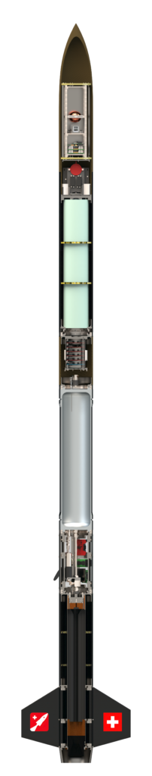
Which Hybrid Propulsion Systems exist?
Hybrid Propulsion Systems:
  Example: EPFL rocket team hybrid rocket
L5 – Propulsion Systems
Space Propulsion ENG-510

Slide 112
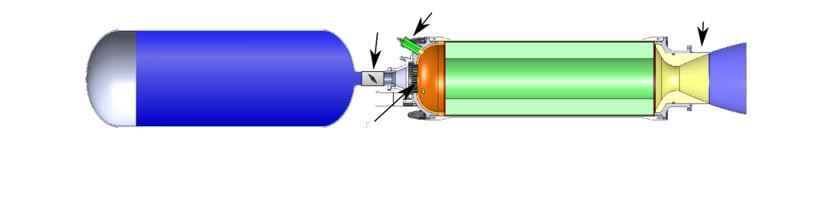
Which Hybrid Propulsion Systems exist?
Hybrid Propulsion Systems:
  Example: Hybrid propulsion system
L5 – Propulsion Systems
Space Propulsion ENG-510

Slide 113
Which Hybrid Propulsion Systems exist?
Hybrid Propulsion Systems:
  Example: Autophage rocket from Alpha Impulsion
  Autophage propulsion is an overhaul of the classical space launcher architecture, using fuel as structure
  As the rocket ascends, the engine gradually burns the rocket’s body, starting from the bottom and moving upwards, getting shorter during the flight like an upside-down candle
  The vehicle consumes itself, until only the engine and the payload remain
L5 – Propulsion Systems
Space Propulsion ENG-510

Slide 114
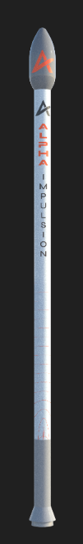
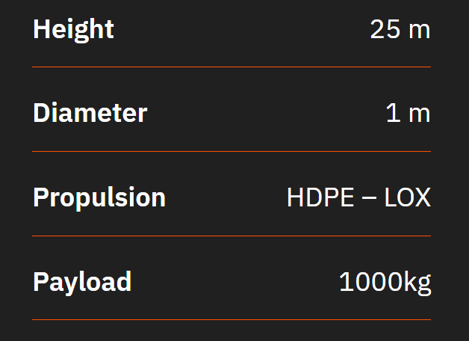
Which Hybrid Propulsion Systems exist?
Hybrid Propulsion Systems:
  Example: Autophage rocket from Alpha Impulsion
L5 – Propulsion Systems
Space Propulsion ENG-510

Slide 115
Which Chemical Propulsion Systems exist?
Gaseous propulsion systems
Liquid propulsion systems
Gelled propulsion systems
Combustion
Hybrid propulsion systems
L5 – Propulsion Systems
Chemical Propulsion Systems
Space Propulsion ENG-510
Solid propulsion systems
Rotation Detonation Engine
Detonation
Pulse Detonation Engine

Slide 116
Which Chemical Propulsion Systems exist?
Gaseous Propellant
Liquid propellant
Rotation Detonation Engine
Rotation Detonation Engine
Detonation
L5 – Propulsion Systems
Chemical Propulsion Systems
Space Propulsion ENG-510
Combustion

Slide 117
Which Chemical Propulsion Systems exist?
Rotation Detonation Engine
Principle
  The basic concept of an RDE is a detonation wave that travels around a circular channel (annulus)
  Fuel and oxidizer are injected into the channel, normally through small holes or slits
  A detonation is initiated in the fuel / oxidizer mixture by some form of igniter
  After the engine is started, the detonations are self-sustaining
  One detonation ignites the fuel / oxidizer mixture, which releases the energy necessary to sustain the detonation
  The combustion products expand out of the channel and are pushed out of the channel by the incoming fuel and oxidizer
L5 – Propulsion Systems
Space Propulsion ENG-510

Slide 118
Which Chemical Propulsion Systems exist?
Rotation Detonation Engine
Principle
  Although the RDE's design is similar to the pulse detonation engie (PDE), the RDE can function continuously because the waves cycle around the chamber, while the PDE requires the chambers to be purged after each pulse
  In detonative combustion, the flame front expands at supersonic speed
  It is theoretically up to 25% more efficient than conventional deflagrative combustion offering potentially major fuel savings
  Disadvantages include instability and noise
L5 – Propulsion Systems
Space Propulsion ENG-510

Slide 119
Which Chemical Propulsion Systems exist?
Rotation Detonation Engine
Principle
  From a thermodynamic point of view, detonations are more efficient than the more commonly known deflagration (classic combustion)
  While classic combustion in rocket engines takes place at constant pressure or even with a slight loss of pressure, the pressure increases significantly during detonation
  A rocket engine based on detonative combustion could therefore theoretically have significantly higher efficiency than today’s engines
L5 – Propulsion Systems
Space Propulsion ENG-510

Slide 120
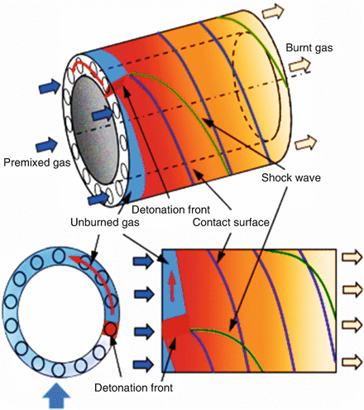
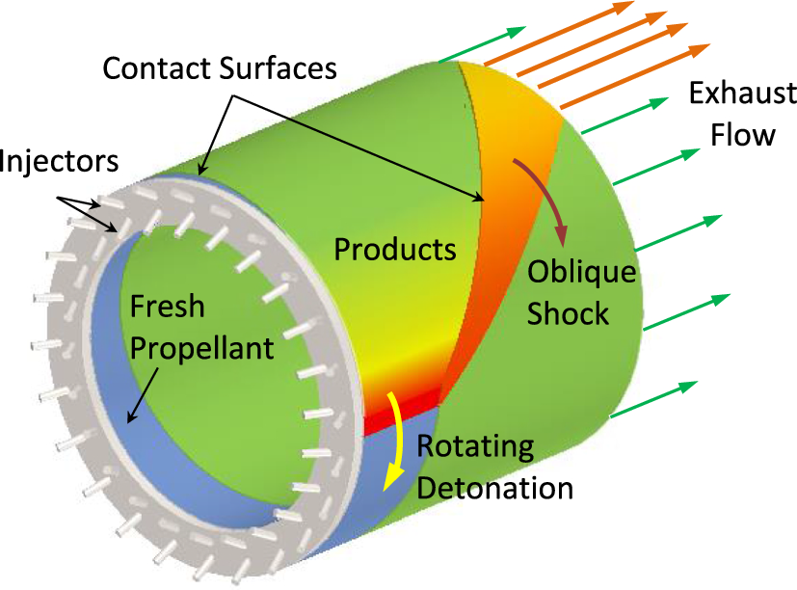
Which Chemical Propulsion Systems exist?
Rotation Detonation Engine
Principle
L5 – Propulsion Systems
Space Propulsion ENG-510

Slide 121
Which Chemical Propulsion Systems exist?
  PTE (Pulse Detonation Engine)
Principle
  A pulse detonation engine (PDE) is a type of propulsion system that uses detonation waves to combust the fuel and oxidizer mixture
  The engine is pulsed because the mixture must be renewed in the combustion chamber between each detonation wave and the next
  Theoretically, a PDE can operate from subsonic up to a hypersonic flight speed of roughly Mach 5
  Key issues for further development include fast and efficient mixing of the fuel and oxidizer, the prevention of autoignition, and integration with an inlet and nozzle
L5 – Propulsion Systems
Space Propulsion ENG-510

Slide 122
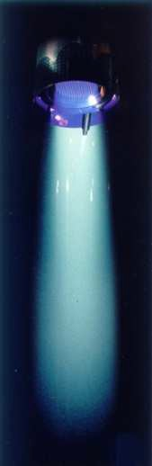
Lecture # 5
Eletrical Propulsion Systems
Brief overview on all space propulsion systems

Slide 123
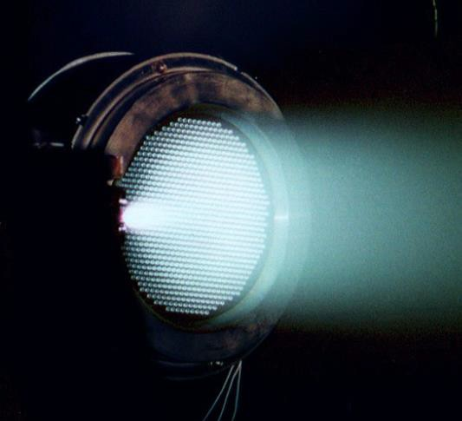
Which Electrical Propulsion Systems exist?
L5 – Propulsion Systems
Space Propulsion ENG-510

Slide 124
Which Electrical Propulsion Systems exist?
Electrical Propulsion Systems:
Thermal Propulsion Systems
Material Ejection
L5 – Propulsion Systems
Space Propulsion
Space Propulsion ENG-510
Chemical Propulsion Systems
Non-Material Ejection
Electrical Propulsion Systems

Slide 125
Thermal Propulsion Systems
Gridded Ion Thruster
Hall Effect Thruster
ResistojetThruster
Electrothermal
CUSP Field Thruster
Arcjet Thruster
Field Emission EP
Electrostatic
L5 – Propulsion Systems
Electrical Propulsion Systems
Electrospray (Colloid) Thruster
Space Propulsion ENG-510
MPD Thruster
Pulsed Plasma Thruster
Electromagnetic
Magnetic Nozzle Thruster

Slide 126
Electrical Propulsion Systems

Slide 127
Which Electrical Propulsion Systems exist?
  Electrical Propulsion Systems:
Performance description
  Isp
  Thrust
  Propellant mass compared to delta v requirement
  Structural mass
  Power need
L5 – Propulsion Systems
Space Propulsion ENG-510

Slide 128
Which Electrical Propulsion Systems exist?
  Electrical Propulsion Systems:
Electric Propulsion Definitions
  Electric propulsion (EP): Any propulsion system which uses electrical power to provide propellant acceleration, and hence thrust
    Excludes systems which only use power for thermal control, valve actuation, etc.
    Implicitly includes “hybrid” systems, which use electrical power to accelerate combustion products of chemical thrusters (considered as thermal propulsion system in this course)
  Solar electric propulsion (SEP) uses solar energy (from solar arrays) as power source
  Alternatives are radio-isotope electric propulsion (REP) and nuclear electric propulsion (NEP)
    Comparatively low level of development
L5 – Propulsion Systems
Space Propulsion ENG-510

Slide 129
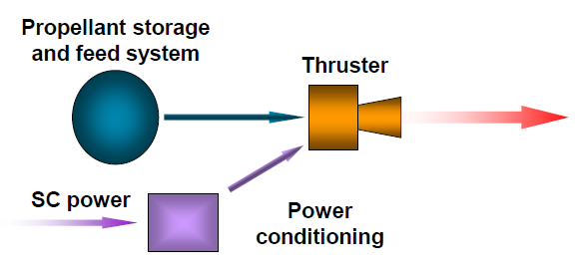
Which Electrical Propulsion Systems exist?
  Electrical Propulsion Systems:
Basics
  For all EP, the following elements are required:
    Propellant storage and feed system
    Electrical power supply and power conditioning
    Power conditioning is usually considered to be part of the EP system; the power supply is part of the overall spacecraft power system architecture
    The thruster, which converts the electrical power into propellant kinetic energy, providing thrust
    Many EP systems also use thrust pointing mechanisms (gimbals), to ensure thrust vector passes through spacecraft center of mass
L5 – Propulsion Systems
Space Propulsion ENG-510

Slide 130
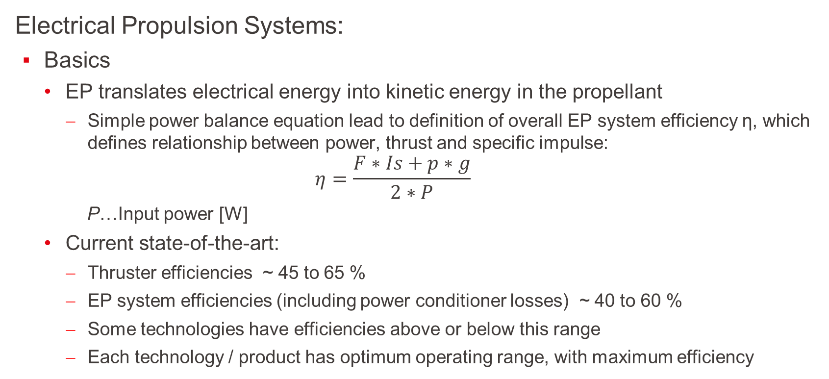
Which Electrical Propulsion Systems exist?
  Electrical Propulsion Systems:
Basics
  EP translates electrical energy into kinetic energy in the propellant
    Simple power balance equation lead to definition of overall EP system efficiency η, which defines relationship between power, thrust and specific impulse:
    $$η=\frac{F∗Is+p∗g}{2∗P}$$
    P…Input power [W]
  Current state-of-the-art:
    Thruster efficiencies ~ 45 to 65 %
    EP system efficiencies (including power conditioner losses) ~ 40 to 60 %
    Some technologies have efficiencies above or below this range
    Each technology / product has optimum operating range, with maximum efficiency
L5 – Propulsion Systems
Space Propulsion ENG-510

Slide 131
Which Electrical Propulsion Systems exist?
  Electrical Propulsion Systems:
Basics
  Electrothermal (or part of Thermal Propulsion Systems…)
    Power heats propellant
    Expansion through a nozzle (same as for a chemical thruster)
  Electrostatic
    Propellant is ionized
    Accelerated using electrostatic fields
  Electromagnetic
    Propellant is ionized
    Accelerated by interaction of discharge current with magnetic field (JxB Lorentz force)
L5 – Propulsion Systems
Space Propulsion ENG-510

Slide 132
Which Electrical Propulsion Systems exist?
  Electric Propulsion Systems:
B
  C
    D
L5 – Propulsion Systems
Space Propulsion ENG-510

Slide 133
Which Electrical Propulsion Systems exist?
  Electrical Propulsion Systems:
Basics
  Plasma is needed…
L5 – Propulsion Systems
Space Propulsion ENG-510

Slide 134
Which Electrical Propulsion Systems exist?
  Electric Propulsion Systems:
Basics
  What is Plasma?
L5 – Propulsion Systems
Space Propulsion ENG-510

Slide 135
Which Electrical Propulsion Systems exist?
  Electrical Propulsion Systems:
Basics
  What is Plasma? A combination of gas dynamics with electromagnetism
    Interaction with E & B fields
    Rarefied gas (basically not continuum modeling)
    Mixture of particles of completely-different-nature
L5 – Propulsion Systems
Space Propulsion ENG-510

Slide 136
Thermal Propulsion Systems
Gridded Ion Thruster
Hall Effect Thruster
ResistojetThruster
Electrothermal
CUSP Field Thruster
Arcjet Thruster
Field Emission EP
Electrostatic
L5 – Propulsion Systems
Electrical Propulsion Systems
Electrospray (Colloid) Thruster
Space Propulsion ENG-510
MPD Thruster
Pulsed Plasma Thruster
Electromagnetic
Magnetic Nozzle Thruster

Slide 137
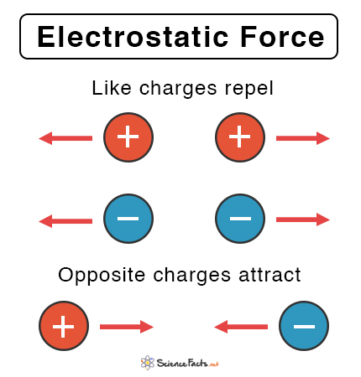
Which Electrical Propulsion Systems exist?
  Electrostatic Propulsion Systems:
Electrostatic Force:
  The electrostatic force is the force of attraction or
  repulsion between two charged particles
  It is also called Coulomb’s force or Coulomb’s
  interaction
L5 – Propulsion Systems
Space Propulsion ENG-510

Slide 138
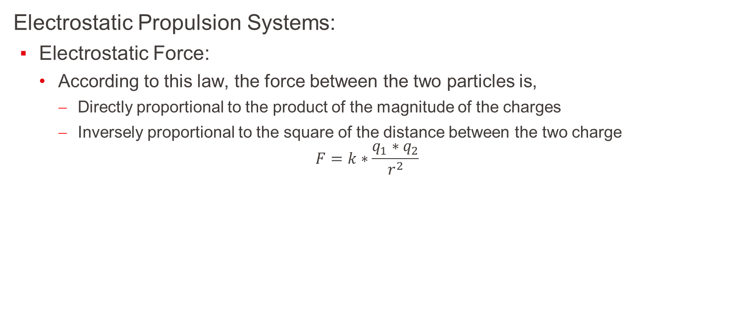
Which Electrical Propulsion Systems exist?
  Electrostatic Propulsion Systems:
Electrostatic Force:
  According to this law, the force between the two particles is,
    Directly proportional to the product of the magnitude of the charges
    Inversely proportional to the square of the distance between the two charge
$$F=k∗\frac{q_{1}∗q_{2}}{r^{2}}$$
L5 – Propulsion Systems
Space Propulsion ENG-510

Slide 139
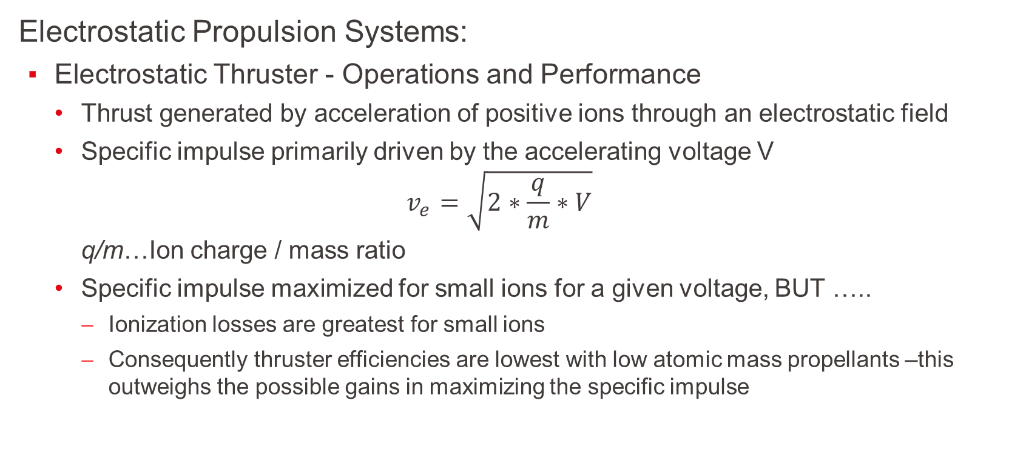
Which Electrical Propulsion Systems exist?
  Electrostatic Propulsion Systems:
Electrostatic Thruster - Operations and Performance
  Thrust generated by acceleration of positive ions through an electrostatic field
  Specific impulse primarily driven by the accelerating voltage V
  $$v_{e}=\sqrt{2∗\frac{q}{m}∗V}$$
  q/m…Ion charge / mass ratio
  Specific impulse maximized for small ions for a given voltage, BUT …..
    Ionization losses are greatest for small ions
    Consequently thruster efficiencies are lowest with low atomic mass propellants –this outweighs the possible gains in maximizing the specific impulse
L5 – Propulsion Systems
Space Propulsion ENG-510

Slide 140
Which Electrical Propulsion Systems exist?
  Electrostatic Propulsion Systems:
Electrostatic Thruster - Operations and Performance
  High atomic mass propellants are preferred
  More complex molecules avoided as they can dissociate during ionization
  Multiple charged ions are also avoided (as far as is possible), as their production and acceleration is less efficient than that for singly charged ions
L5 – Propulsion Systems
Space Propulsion ENG-510

Slide 141
Which Electrical Propulsion Systems exist?
  Electrostatic Propulsion Systems:
Electrostatic Thruster - Operations and Performance
  Xenon is the “industry standard” propellant for electrostatic systems
    Noble gas (inert): no chemical reaction with the other parts of the system
    High atomic mass (~131): high thrust
    Low ionization energy: no too much energy lost for ionization
    Gaseous at ambient temperature: no need to vaporize it to feed the thruster
    High compression rate: not too big tanks at a reasonable pressure (150bar)
    However it is present in low quantity on the Earth (0.08 ppm of the air) and is therefore very expensive (~ 3000 € / kg)
L5 – Propulsion Systems
Space Propulsion ENG-510

Slide 142
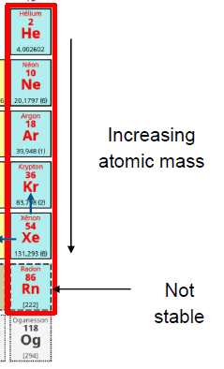
Which Electrical Propulsion Systems exist?
  Electrostatic Propulsion Systems:
Electrostatic Thruster - Operations and Performance
  That is why alternate propellants are currently investigated
  (mainly Krypton and Iodine)
  Xenon production and market:
    Xenon (as well as Krypton) is made from air separation
    World production: ≈ 70 t/year
    Space industry is about 30 % of the need
    Other industries are mainly lighting and electronics
L5 – Propulsion Systems
Space Propulsion ENG-510

Slide 143
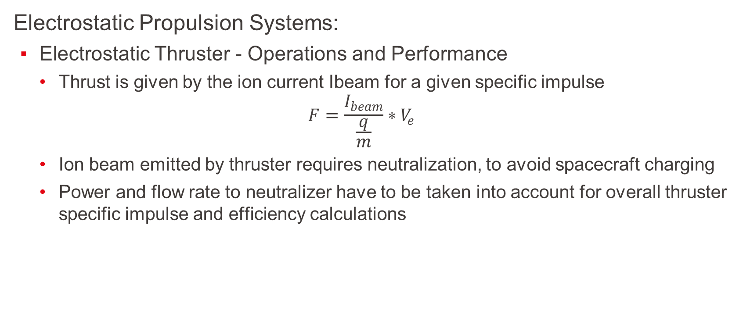
Which Electrical Propulsion Systems exist?
  Electrostatic Propulsion Systems:
Electrostatic Thruster - Operations and Performance
  Thrust is given by the ion current Ibeam for a given specific impulse
  $$F=\frac{I_{beam}}{\frac{q}{m}}∗V_{e}$$
  Ion beam emitted by thruster requires neutralization, to avoid spacecraft charging
  Power and flow rate to neutralizer have to be taken into account for overall thruster specific impulse and efficiency calculations
L5 – Propulsion Systems
Space Propulsion ENG-510

Slide 144
Thermal Propulsion Systems
Gridded Ion Thruster
Hall Effect Thruster
ResistojetThruster
Electrothermal
CUSP Field Thruster
Arcjet Thruster
Field Emission EP
Electrostatic
L5 – Propulsion Systems
Electrical Propulsion Systems
Electrospray (Colloid) Thruster
Space Propulsion ENG-510
MPD Thruster
Pulsed Plasma Thruster
Electromagnetic
Magnetic Nozzle Thruster

Slide 145

Which Electrical Propulsion Systems exist?
L5 – Propulsion Systems
Space Propulsion ENG-510

Slide 146
Which Electrical Propulsion Systems exist?
  Electrostatic Propulsion Systems:
  (Gridded) Ion Thruster:
  Gridded ion thrusters employ a variety of plasma generation techniques to ionize large fraction of the propellant
  These thrusters then utilize biased grids to electrostatically extract ions from the plasma and accelerate them to high velocities at voltage up to and exceeding
  10 kV
  Ion thrusters feature the highest efficiency (from 60 % to > 80 %) and very high specific impulse (from 2.000 s to over 10.000 s) compared to other thruster types
L5 – Propulsion Systems
Space Propulsion ENG-510

Slide 147

Which Electrical Propulsion Systems exist?
L5 – Propulsion Systems
Space Propulsion ENG-510

Slide 148
Which Electrical Propulsion Systems exist?
  Electrostatic Propulsion Systems:
  Gridded Ion Thruster - Two main types of ion thruster, depending on the ionisation technique used:
  Radio-Frequency (RF) Discharge:
    Xenon flowed into discharge chamber
    RF-current applied to coil; results in a primary axial magnetic field being induced inside the ioniser, which generates a secondary circular electric field (E)
    Free electrons (from neutraliser) ionise the propellant
    Once ionisation process is initially triggered the process is self-sustaining, with all electrons required for steady state operation being generated by this discharge process
L5 – Propulsion Systems
Space Propulsion ENG-510

Slide 149

Which Electrical Propulsion Systems exist?
  Electrostatic Propulsion Systems:
  Gridded Ion Thruster - Two main types of ion thruster, depending on the ionisation technique used:
  Radio-Frequency (RF) Discharge:
L5 – Propulsion Systems
Space Propulsion ENG-510

Slide 150
Which Electrical Propulsion Systems exist?
  Electrostatic Propulsion Systems:
  Gridded Ion Thruster:
  Electron-Bombardment (Kauffman type):
    Cathode located at back of the discharge chamber provides electrons for discharge ionisation
    Xenon ionised by bombardment by the electrons from the cathode as they are accelerated towards discharge chamber anode
    Internal magnetic field forces electrons to follow spiral path, increasing ionisation efficiency
    Thruster shown here uses solenoids to generate the internal magnetic field; some thrusters use permanent magnets instead
L5 – Propulsion Systems
Space Propulsion ENG-510

Slide 151

Which Electrical Propulsion Systems exist?
  Electrostatic Propulsion Systems:
  Gridded Ion Thruster:
  Electron-Bombardment (Kauffman type):
L5 – Propulsion Systems
Space Propulsion ENG-510

Slide 152
Which Electrical Propulsion Systems exist?
  Electrostatic Propulsion Systems:
  Gridded Ion Thruster:
  Xenon ions accelerated by potential difference between screen and accelerator grids, producing thrust
    Neutralizer provides electrons to prevent spacecraft charging
  Typically operate at beam voltages of 1 to 2 kV or higher, depending on the specific impulse required
    Acceleration grid is normally negatively biased (a few hundred volts); this prevents external electrons from being attracted into the discharge chamber
  Acceleration grid erodes due to ion impingement
    Ion optics design avoids direct impingement; erosion caused by charge exchange between fast ions and slow neutrals in vicinity of grids
    Grid life normally ~ > 25000 hours
L5 – Propulsion Systems
Space Propulsion ENG-510

Slide 153
Which Electrical Propulsion Systems exist?
  Electrostatic Propulsion Systems:
  Gridded Ion Thruster:
  High throttling range (~ 2:1 to 5:1)
  Operation of a single thruster over a range of beam voltages (i.e. variable Isp) is possible but difficult
    Grid ion optics are optimized for a given voltage (and hence Isp)
  Ion thruster efficiencies ~ 35 % for small thrusters up to ~ 80 % for large thrusters
  Low beam divergence (typically < 15 ° half cone angle)
L5 – Propulsion Systems
Space Propulsion ENG-510

Slide 154
Which Electrical Propulsion Systems exist?
  Electrostatic Propulsion Systems:
  Gridded Ion Thruster:
  Ions Acceleration Principle:
    Once the plasma (mix of ions and electrons) is created inside the ionization vessel, since it is a conductive medium, it is at the screen grid potential (several hundreds of volts)
    Then the ions are accelerated due to the difference of potential between the screen grid and the plasma at infinity (i.e. 0V)
L5 – Propulsion Systems
Space Propulsion ENG-510

Slide 155

Which Electrical Propulsion Systems exist?
  Electrostatic Propulsion Systems:
  Gridded Ion Thruster:
  Ions Acceleration Principle:
L5 – Propulsion Systems
Space Propulsion ENG-510

Slide 156
Which Gridded Ion Electric Propulsion Systems exist (9/70)?
Objective: To develop the basics of Gridded Ion EP
Gridded Ion EP
  B
Space Propulsion ENG-510

Slide 157

Which Gridded Ion Electric Propulsion Systems exist (10/70)?
Objective: To develop the basics of Gridded Ion EP
Gridded Ion EP
  B
Highest exhaust velocities
Highest electric efficiency
Highly scalable
Perfect thrust control
Ionisation
Acceleration
Space Propulsion ENG-510

Slide 158
Which Gridded Ion Electric Propulsion Systems exist (8/x)?
Objective: To develop the basics of Gridded Ion EP
Gridded Ion EP
  B
Space Propulsion ENG-510

Slide 159
Which Gridded Ion Electric Propulsion Systems exist (13/70)?
Objective: To develop the basics of Gridded Ion EP
Gridded Ion EP
  B
Space Propulsion ENG-510

Slide 160
Which Gridded Ion Electric Propulsion Systems exist (14/70)?
Objective: To develop the basics of Gridded Ion EP
Gridded Ion EP
  Working fluid generation:
    DC-discharge
    Radio Frequency
    Microwave
Space Propulsion ENG-510

Slide 161
Which Gridded Ion Electric Propulsion Systems exist (15/70)?
Objective: To develop the basics of Gridded Ion EP
Gridded Ion EP
Space Propulsion ENG-510

Slide 162
Which Gridded Ion Electric Propulsion Systems exist (12/x)?
Objective: To develop the basics of Gridded Ion EP
Gridded Ion EP
Space Propulsion ENG-510

Slide 163
Which Gridded Ion Electric Propulsion Systems exist (17/70)?
Objective: To develop the basics of Gridded Ion EP
Gridded Ion EP
  Basic principle of an ion thruster = ion production cost (power needed for creation of ions)
Space Propulsion ENG-510

Slide 164
Which Gridded Ion Electric Propulsion Systems exist (18/70)?
Objective: To develop the basics of Gridded Ion EP
Gridded Ion EP
  Basic principle of an ion thruster: If you want to increase the thrust…
Space Propulsion ENG-510

Slide 165
Which Gridded Ion Electric Propulsion Systems exist (19/70)?
Objective: To develop the basics of Gridded Ion EP
Gridded Ion EP
  Basic principle of an ion thruster: You need increase the number of ions flowing
Space Propulsion ENG-510

Slide 166
Which Gridded Ion Electric Propulsion Systems exist (20/70)?
Objective: To develop the basics of Gridded Ion EP
Gridded Ion EP
  Basic principle of an ion thruster: But ions are repelling each other
Space Propulsion ENG-510

Slide 167
Which Gridded Ion Electric Propulsion Systems exist (21/70)?
Objective: To develop the basics of Gridded Ion EP
Gridded Ion EP
  Basic principle of an ion thruster: Space Charge Limitation Current
Space Propulsion ENG-510

Slide 168
Which Gridded Ion Electric Propulsion Systems exist (24/70)?
Objective: To develop the basics of Gridded Ion EP
Gridded Ion EP
  DC discharge:
  Electron acceleration ->
  Ionization
  Hollow cathode as
  electron source
  Anode potential discharge
  chamber with magnetic
  multipole boundaries
Space Propulsion ENG-510

Slide 169
Which Gridded Ion Electric Propulsion Systems exist (40/70)?
Objective: To develop the basics of Gridded Ion EP
Gridded Ion EP
  Example: Kaufman thruster
Space Propulsion ENG-510

Slide 170
Which Gridded Ion Electric Propulsion Systems exist (41/70)?
Objective: To develop the basics of Gridded Ion EP
Gridded Ion EP
  RF discharge:
  RF current on
  outside coil ->
  Inducing current
Space Propulsion ENG-510

Slide 171
Which Gridded Ion Electric Propulsion Systems exist (43/70)?
Objective: To develop the basics of Gridded Ion EP
Gridded Ion EP
  Example:
  AGG RIT thruster
Space Propulsion ENG-510

Slide 172
Huge thruster have the problem at
Grid systems

Slide 173


Which Gridded Ion Electric Propulsion Systems exist (45/70)?
Objective: To develop the basics of Gridded Ion EP
Gridded Ion EP
  Manufacturing (number of holes, material, …)
  Shape
Space Propulsion ENG-510

Slide 174
Which Gridded Ion Electric Propulsion Systems exist (46/70)?
Objective: To develop the basics of Gridded Ion EP
Gridded Ion EP
  Alignment
  Hot conditions
Space Propulsion ENG-510

Slide 175


Which Gridded Ion Electric Propulsion Systems exist (47/70)?
Objective: To develop the basics of Gridded Ion EP
Gridded Ion EP
  Erosion
Space Propulsion ENG-510

Slide 176
Which Gridded Ion Electric Propulsion Systems exist (48/70)?
Objective: To develop the basics of Gridded Ion EP
Gridded Ion EP
  Erosion linked to position…
Space Propulsion ENG-510

Slide 177


Which Gridded Ion Electric Propulsion Systems exist (49/70)?
Objective: To develop the basics of Gridded Ion EP
Gridded Ion EP
  Arcs
Space Propulsion ENG-510

Slide 178
Huge thruster have the problem at
Grid systems
But not only as there is also

Slide 179

Which Gridded Ion Electric Propulsion Systems exist (51/70)?
Objective: To develop the basics of Gridded Ion EP
Gridded Ion EP
  Harness
  RFG
  Neutralizer
  Ceramic
  Testing on Ground (Vacuum level -> Paschen curve, sputter material)
  Gas Inlet
  …
Space Propulsion ENG-510

Slide 180

Which Gridded Ion Electric Propulsion Systems exist (52/70)?
Objective: To develop the basics of Gridded Ion EP
Gridded Ion EP
  Testing on Ground
  (Vacuum level -> Paschen curve)
Space Propulsion ENG-510

Slide 181
Which Gridded Ion Electric Propulsion Systems exist (53/70)?
Objective: To develop the basics of Gridded Ion EP
Gridded Ion EP
  Testing on Ground (Sputter material)
Space Propulsion ENG-510

Slide 182

Which Gridded Ion Electric Propulsion Systems exist (47/x)?
Objective: To develop the basics of Gridded Ion EP
Gridded Ion EP
  Gas Inlet
Space Propulsion ENG-510

Slide 183
Which Gridded Ion Electric Propulsion Systems exist (58/70)?
Objective: To develop the basics of Gridded Ion EP
Gridded Ion EP
  Microwave discharge:
  Emitting microwave ->
  Oscillating electric fields
Space Propulsion ENG-510

Slide 184
Thermal Propulsion Systems
Gridded Ion Thruster
Hall Effect Thruster
ResistojetThruster
Electrothermal
CUSP Field Thruster
Arcjet Thruster
Field Emission EP
Electrostatic
L5 – Propulsion Systems
Electrical Propulsion Systems
Electrospray (Colloid) Thruster
Space Propulsion ENG-510
MPD Thruster
Pulsed Plasma Thruster
Electromagnetic
Magnetic Nozzle Thruster

Slide 185

Which Electrical Propulsion Systems exist?
  Electrostatic Propulsion Systems:
  Hall Effect Thruster:
  C
    D
L5 – Propulsion Systems
Space Propulsion ENG-510

Slide 186
Which Electrical Propulsion Systems exist?
  Electrostatic Propulsion Systems:
  Hall Effect Thruster:
  This type of electrostatic thruster utilizes a cross-field discharge described by the Hall effect to generate the plasma
  An electric field established perpendicular to an applied magnetic field electrostatically accelerates ions to high exhaust velocities, while transverse magnetic field inhibits electron motion that would tend to short out the electric field
  Hall thruster efficiency and specific impulse is less compared to Gridded Ion thrusters, but the thrust at a given power is higher and the device is much simpler and requires fewer power supplies to operate
L5 – Propulsion Systems
Space Propulsion ENG-510

Slide 187

Which Electrical Propulsion Systems exist?
  Electrostatic Propulsion Systems:
  Hall Effect Thruster:
  C
    D
L5 – Propulsion Systems
Space Propulsion ENG-510

Slide 188
Which Electrical Propulsion Systems exist?
  Electrostatic Propulsion Systems:
  Hall Effect Thruster:
  Ions are produced within an annular discharge chamber by electron bombardment
    Electrons provided by external cathode
    Propellant flowed into discharge chamber through anode at rear of discharge chamber
    Magnets trap the electrons, increasing ionization rate
  Ions accelerated by electric field between anode and space
    Cathodes also provide electrons for plume neutralization
  HETs typically operate at 300 to 350 V
    Higher voltages are used for higher specific impulse options
  Beam divergence relatively high (45 ° half cone angle)
L5 – Propulsion Systems
Space Propulsion ENG-510

Slide 189

Which Electrical Propulsion Systems exist?
  Electrostatic Propulsion Systems:
  Hall Effect Thruster:
  C
    D
L5 – Propulsion Systems
Space Propulsion ENG-510

Slide 190


Which Electrical Propulsion Systems exist?
  Electrostatic Propulsion Systems:
  Hall Effect Thruster:
L5 – Propulsion Systems
Space Propulsion ENG-510

Slide 191


Which Electrical Propulsion Systems exist?
  Electrostatic Propulsion Systems:
  Hall Effect Thruster:
  C
    D
L5 – Propulsion Systems
Space Propulsion ENG-510

Slide 192
Thermal Propulsion Systems
Gridded Ion Thruster
Hall Effect Thruster
ResistojetThruster
Electrothermal
CUSP Field Thruster
Arcjet Thruster
Field Emission EP
Electrostatic
L5 – Propulsion Systems
Electrical Propulsion Systems
Electrospray (Colloid) Thruster
Space Propulsion ENG-510
MPD Thruster
Pulsed Plasma Thruster
Electromagnetic
Magnetic Nozzle Thruster

Slide 193
Which Electrical Propulsion Systems exist?
  Electrostatic Propulsion System:
ACFT (Advanced Cusp Field Thruster) / HEMPT (High Efficiency Multistage Plasma Thruster) EP
  Cusp field thruster, also known as High Efficiency Multistage Plasma Thruster (HEMPT) and Advanced Cusp Field Thruster (ACFT), refers to the geometry of the magnetic field that influences the flow of electrons and ions
  Similar in principle to a HET, but using a magnetic multistage cusp/mirror confinement of plasma
L5 – Propulsion Systems
Space Propulsion ENG-510

Slide 194

Which Electrical Propulsion Systems exist?
  Electrostatic Propulsion System:
ACFT (Advanced Cusp Field Thruster) / HEMPT (High Efficiency Multistage Plasma Thruster) EP
L5 – Propulsion Systems
Space Propulsion ENG-510

Slide 195
Which Electrical Propulsion Systems exist?
  Electrostatic Propulsion System:
ACFT (Advanced Cusp Field Thruster) / HEMPT (High Efficiency Multistage Plasma Thruster) EP
  Cusp field thruster comprise a dielectric, rotationally symmetric discharge channel with an anode located at the upstream end
  The anode is connected to the power supply and represents the only high voltage electrode of the thruster
  At the same position, the propellant inlet is located
  The discharge channel is surrounded by a system of axially magnetized permanent magnet rings in opposite magnetization
L5 – Propulsion Systems
Space Propulsion ENG-510

Slide 196
Which Electrical Propulsion Systems exist?
  Electrostatic Propulsion System:
ACFT (Advanced Cusp Field Thruster) / HEMPT (High Efficiency Multistage Plasma Thruster) EP
  At the downstream end of the discharge channel, a cathode / neutraliser is placed to provide the starter electrons for igniting the plasma discharge and for neutralizing the ion beam emitted by the thruster in space
  The electrodes create with their applied potentials inside the chamber an essentially axial electric field, which accelerates positive ions towards the chamber exit to produce thrust
L5 – Propulsion Systems
Space Propulsion ENG-510

Slide 197
Which Electrical Propulsion Systems exist?
  Electrostatic Propulsion System:
ACFT (Advanced Cusp Field Thruster) / HEMPT (High Efficiency Multistage Plasma Thruster) EP
  The magnetic rings create a magnetic field almost perpendicular to the electric field, which forces the electrons towards the anode in spiral trajectories which allows more propellant atoms to be ionised, thereby increasing efficiency
  The magnetic field concentrates the plasma on the axis and reducing losses to the ionization chamber walls, increasing the lifetime and efficiency of the thruster
  Their advantages are performance stability, compatibility with any noble gas, low cost and short lead-time
L5 – Propulsion Systems
Space Propulsion ENG-510

Slide 198

Which Electrical Propulsion Systems exist?
  Electrostatic Propulsion System:
ACFT (Advanced Cusp Field Thruster) / HEMPT (High Efficiency Multistage Plasma Thruster) EP
L5 – Propulsion Systems
Space Propulsion ENG-510

Slide 199
Thermal Propulsion Systems
Gridded Ion Thruster
Hall Effect Thruster
ResistojetThruster
Electrothermal
CUSP Field Thruster
Arcjet Thruster
Field Emission EP
Electrostatic
L5 – Propulsion Systems
Electrical Propulsion Systems
Electrospray (Colloid) Thruster
Space Propulsion ENG-510
MPD Thruster
Pulsed Plasma Thruster
Electromagnetic
Magnetic Nozzle Thruster

Slide 200
Which Electrical Propulsion Systems exist?
  Electrostatic Propulsion System:
Field Emission Electric Propulsion
  FEEP thruster is a type of electrostatic EP device that generate very low thrust (< 1 mN) like electrospray thruster
  FEEP thrusters wick or transport liquid metals (typically indium or cesium) along needles, extracting ions from the sharp tip by field emission processes
  Due to their very low thrust, these devices will be used for precision control of spacecraft position or attitude in space
  Use of metallic propellants raises unique concerns regarding contamination of spacecraft
L5 – Propulsion Systems
Space Propulsion ENG-510

Slide 201

Which Electrical Propulsion Systems exist?
  Electrostatic Propulsion System:
Field Emission Electric Propulsion
  Ions extracted from liquid metal surface by evaporation,
  and accelerated by electrostatic field
  With strong electric field, liquid metal surface deforms into Taylor cones
    Shape is determined by balance between electrostatic and surface tension forces
    Above ~ 109 V/m, ions ripped from cone; these ions are then accelerated by the electric field
  Needle effectively forms anode, with neutralizer as cathode
  Propellant reservoir embedded within overall thruster design; propellant feed is by capillary effects
L5 – Propulsion Systems
Space Propulsion ENG-510

Slide 202
Which Electrical Propulsion Systems exist?
  Electrostatic Propulsion System:
Field Emission Electric Propulsion
L5 – Propulsion Systems
Space Propulsion ENG-510

Slide 203
Which Electrical Propulsion Systems exist?
  Electrostatic Propulsion System:
Field Emission Electric Propulsion
  Single needle can provide thrust levels up to around 10 μN
    Above this level ion current is so large that emission geometry is disrupted, and droplets are emitted at lower efficiency
  2 main developments aimed at increasing thrust level up to > 100 μN:
    Clustering of needles
    Slit thruster (For the slit thruster, a series of Taylor cones is generated along the length of the slit)
L5 – Propulsion Systems
Space Propulsion ENG-510

Slide 204

Which Electrical Propulsion Systems exist?
  Electrostatic Propulsion System:
Field Emission Electric Propulsion
  Single needle can provide thrust levels up to around 10 μN
L5 – Propulsion Systems
Space Propulsion ENG-510

Slide 205

Which Electrical Propulsion Systems exist?
  Electrostatic Propulsion System:
Field Emission Electric Propulsion
  Performance summary:
    Overall voltage levels of around 7 to 9 kV
L5 – Propulsion Systems
Space Propulsion ENG-510

Slide 206
Thermal Propulsion Systems
Gridded Ion Thruster
Hall Effect Thruster
ResistojetThruster
Electrothermal
CUSP Field Thruster
Arcjet Thruster
Field Emission EP
Electrostatic
L5 – Propulsion Systems
Electrical Propulsion Systems
Electrospray (Colloid) Thruster
Space Propulsion ENG-510
MPD Thruster
Pulsed Plasma Thruster
Electromagnetic
Magnetic Nozzle Thruster

Slide 207
Which Electrical Propulsion Systems exist?
  Electrostatic Propulsion System:
Electrospray Thruster
  Electrospray thruster is a type of electrostatic EP device that generate very low thrust (< 1 mN) like FEEP
  Electrospray thrusters extract ions or charged droplets from conductive liquids fed through small needles and accelerate them electrostatically with biased, aligned apertures to high energy
  Due to their very low thrust, these devices will be used for precision control of spacecraft position or attitude in space
L5 – Propulsion Systems
Space Propulsion ENG-510

Slide 208

Which Electrical Propulsion Systems exist?
  Electrostatic Propulsion System:
Electrospray Thruster
  Balance of surface tension and electrostatic forces create microscopic droplets
    Droplet size is typically 10 to 100 nm diameter
  Semi-conductive liquid used
  Droplets are extracted and accelerated by either:
    The same applied voltage, or
    Separate extractor and accelerator voltages
  DC operation - needle effectively forms anode, with neutralizer as cathode
    Alternatively, needles can be separately biased +ve and –ve within an array, so no neutraliser needed
L5 – Propulsion Systems
Space Propulsion ENG-510

Slide 209


Which Electrical Propulsion Systems exist?
  Electrostatic Propulsion System:
Electrospray Thruster
  Single needle can provide only a few μN
    Array of needles used to provide higher thrust levels
  Thrust controlled by acceleration voltage and / or propellant flow rate
    Propellant feed is typically at constant pressure
  Beam voltages up to 10 kV
  Typical performance summary
L5 – Propulsion Systems
Space Propulsion ENG-510

Slide 210


Which Electrical Propulsion Systems exist?
  Electrostatic Propulsion System:
Electrospray Thruster
L5 – Propulsion Systems
Space Propulsion ENG-510

Slide 211
Back-up
Brief overview on all space propulsion systems

